Slide 1
School Firefly Group
Tsuruga Kehihuzoku junior high school

Slide 2
Purpose
We started this four years ago when we discovered that fireflies lived at our school and became interested in them.

Slide 3
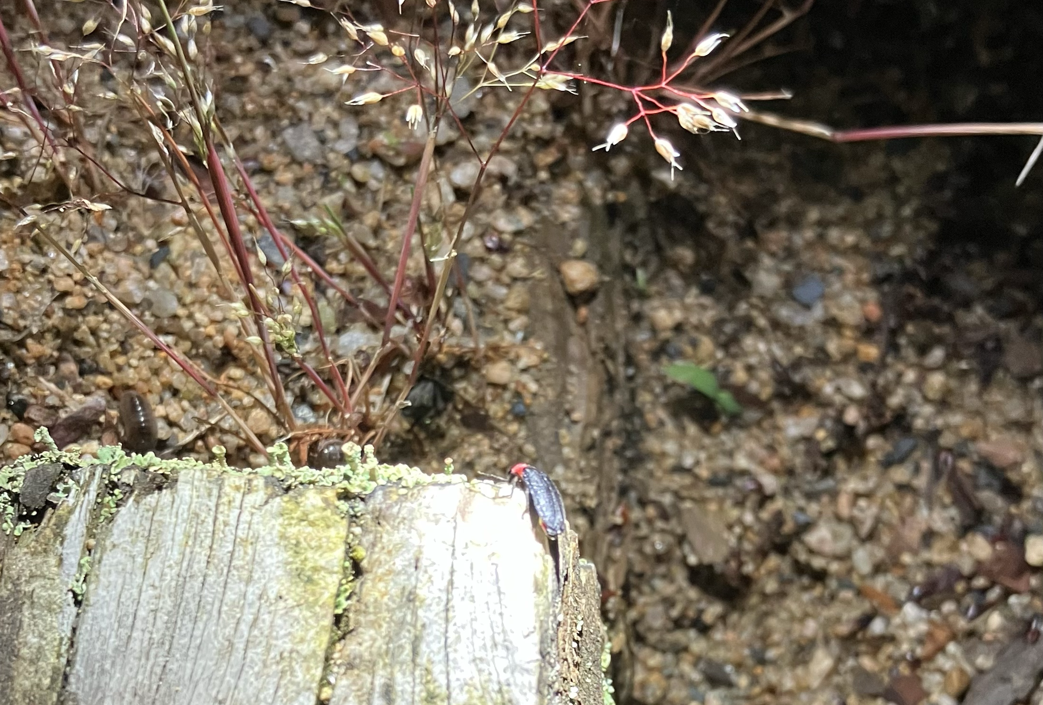
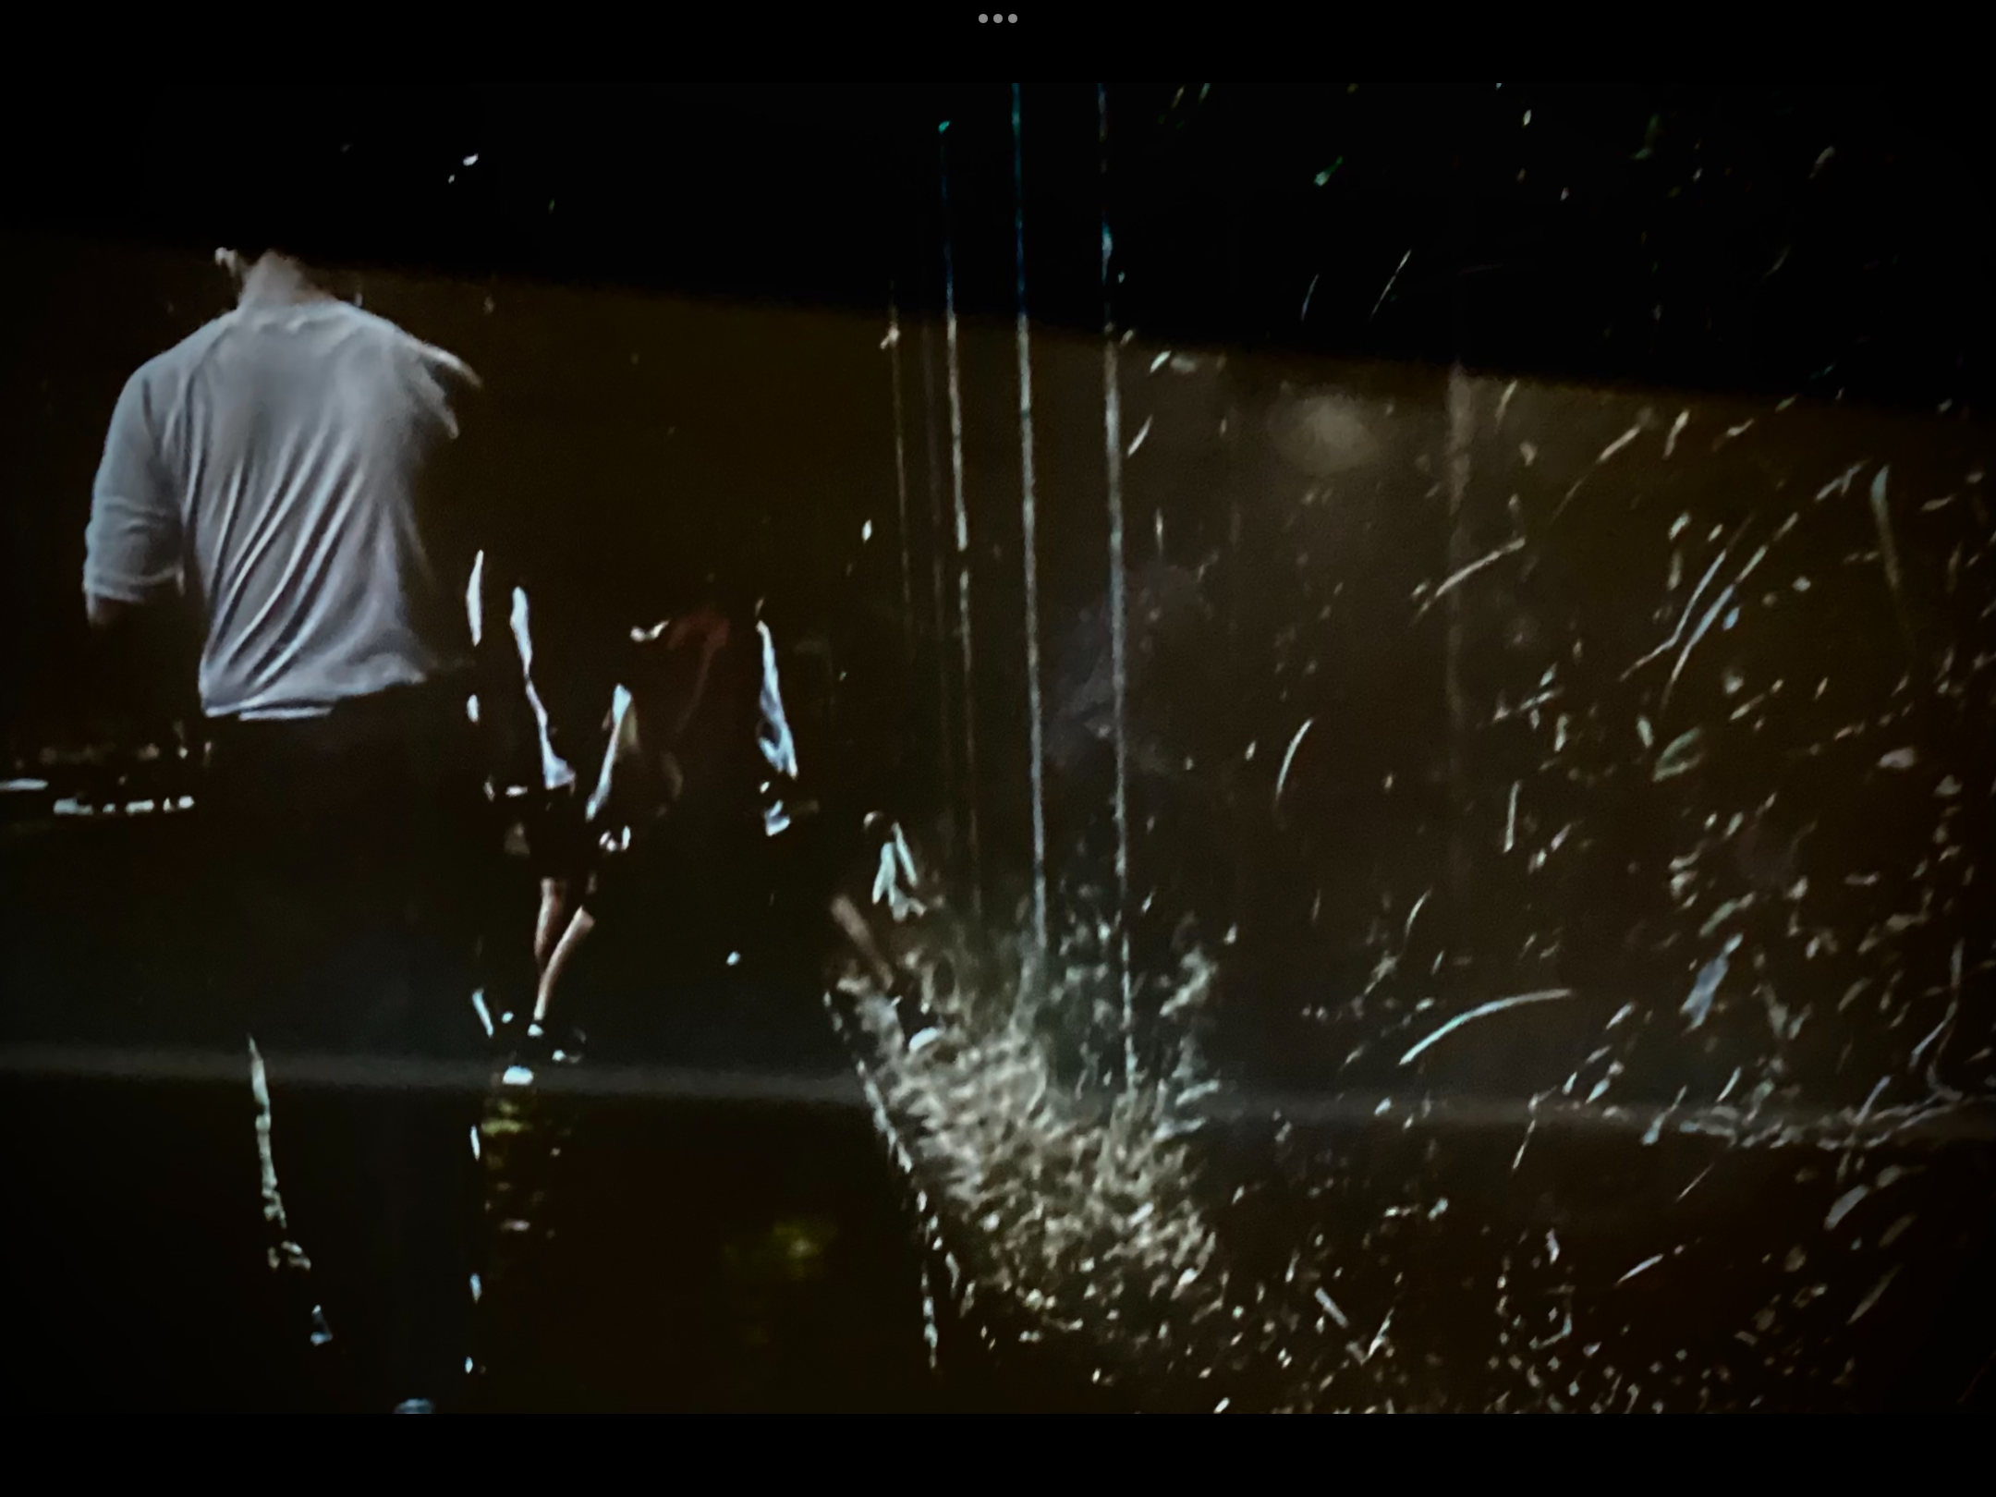
Activities
Observation of fireflies at night

Slide 4
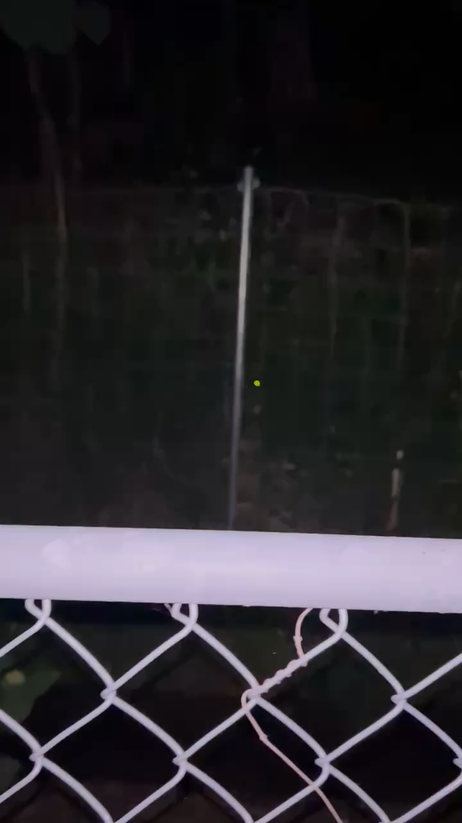

Slide 5
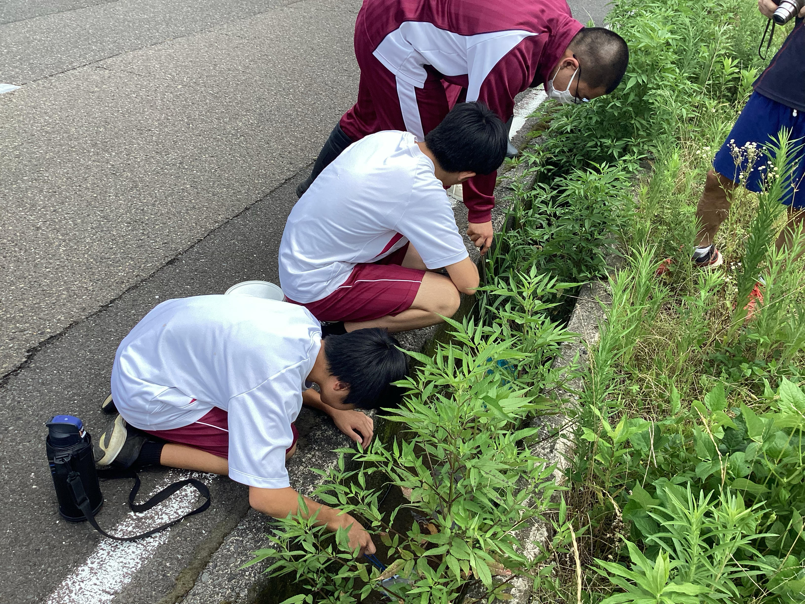
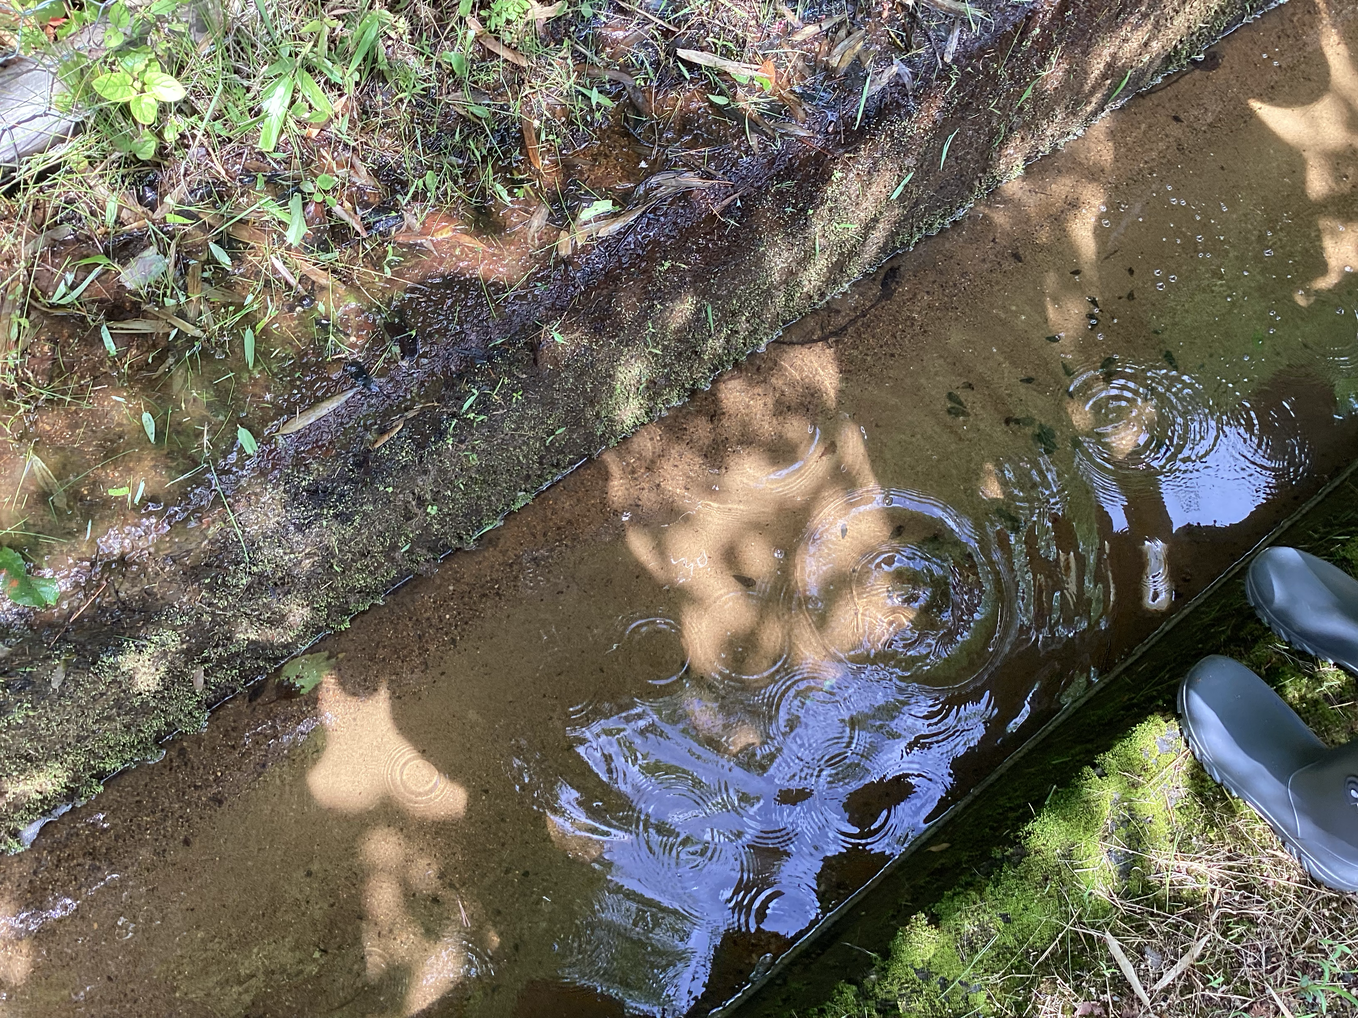
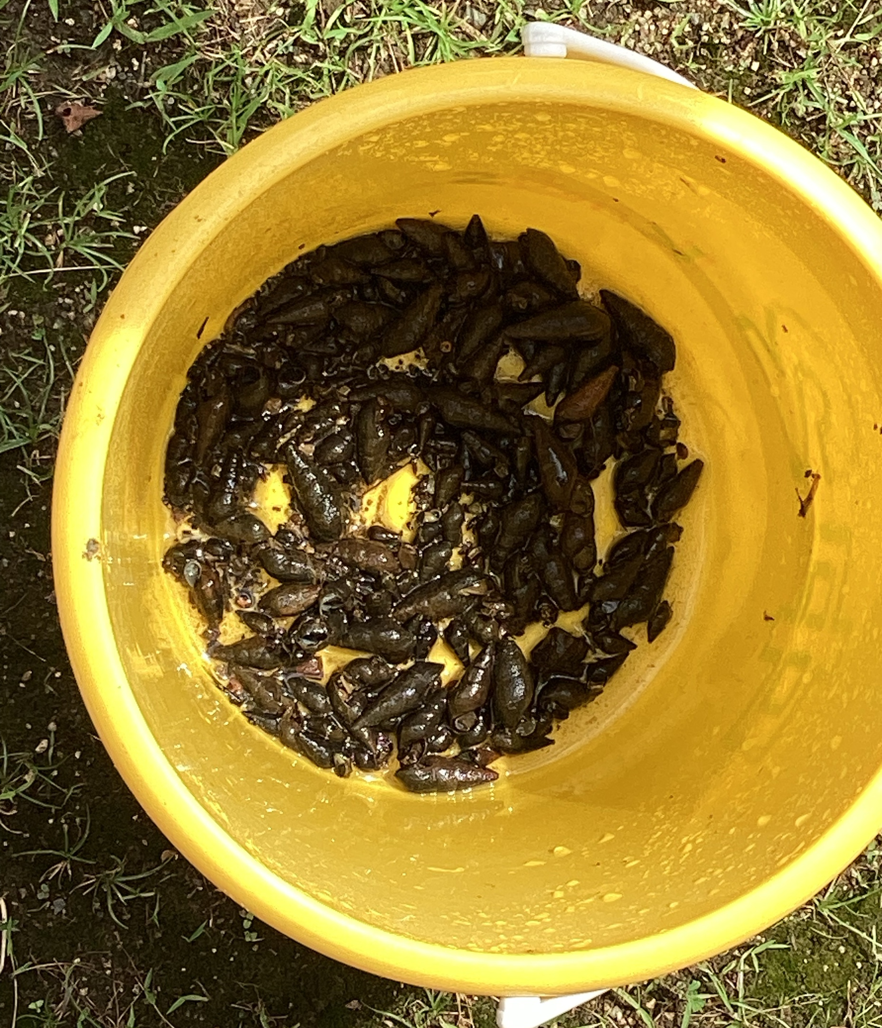
Activity

Slide 6
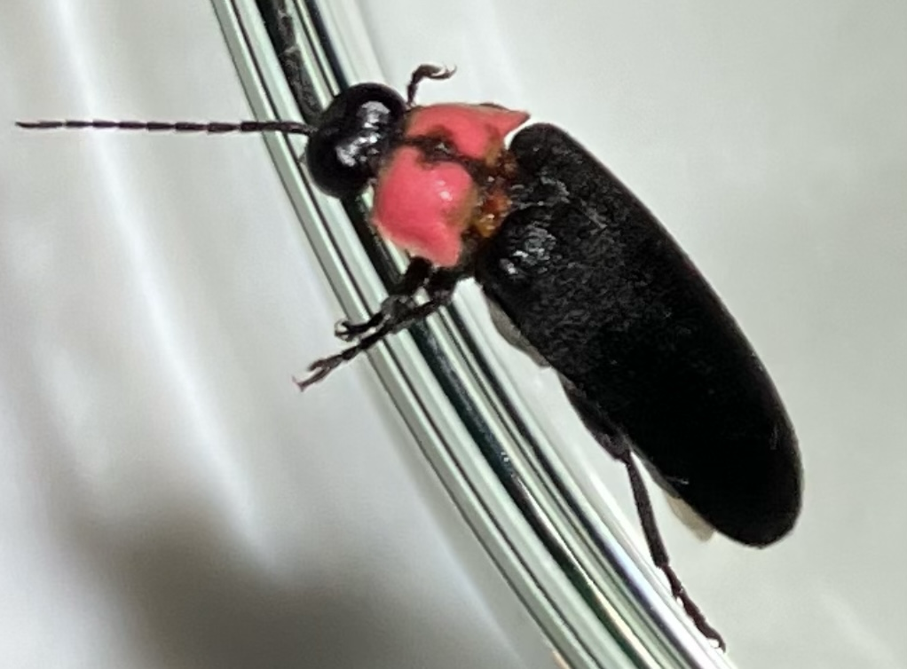
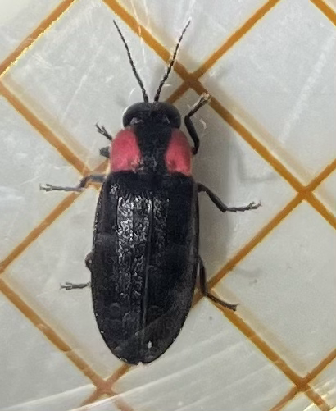
Observation of fireflies

Slide 7
Finally
Fireflies=Environmental barometer
The habitat of fireflies=A diverse environment
=People are livable

Slide 8
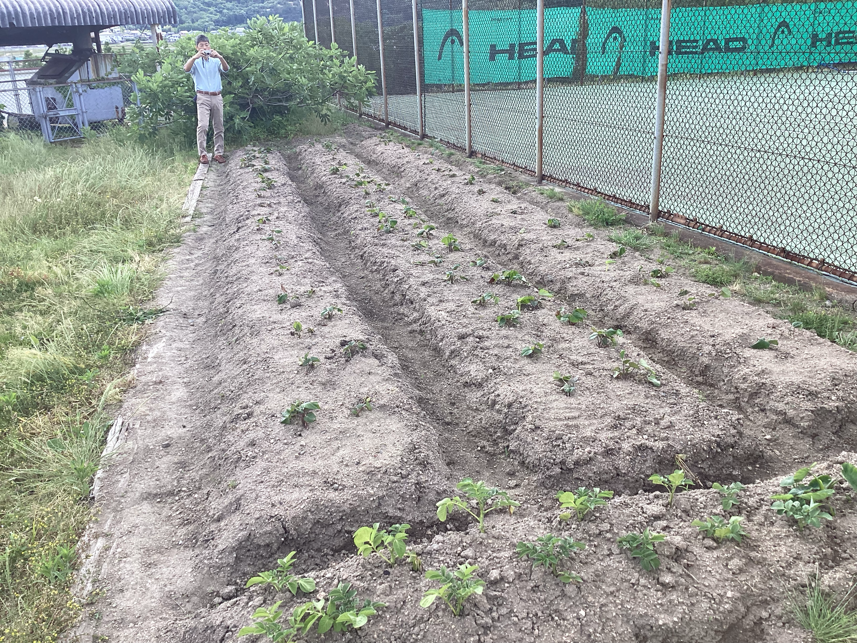
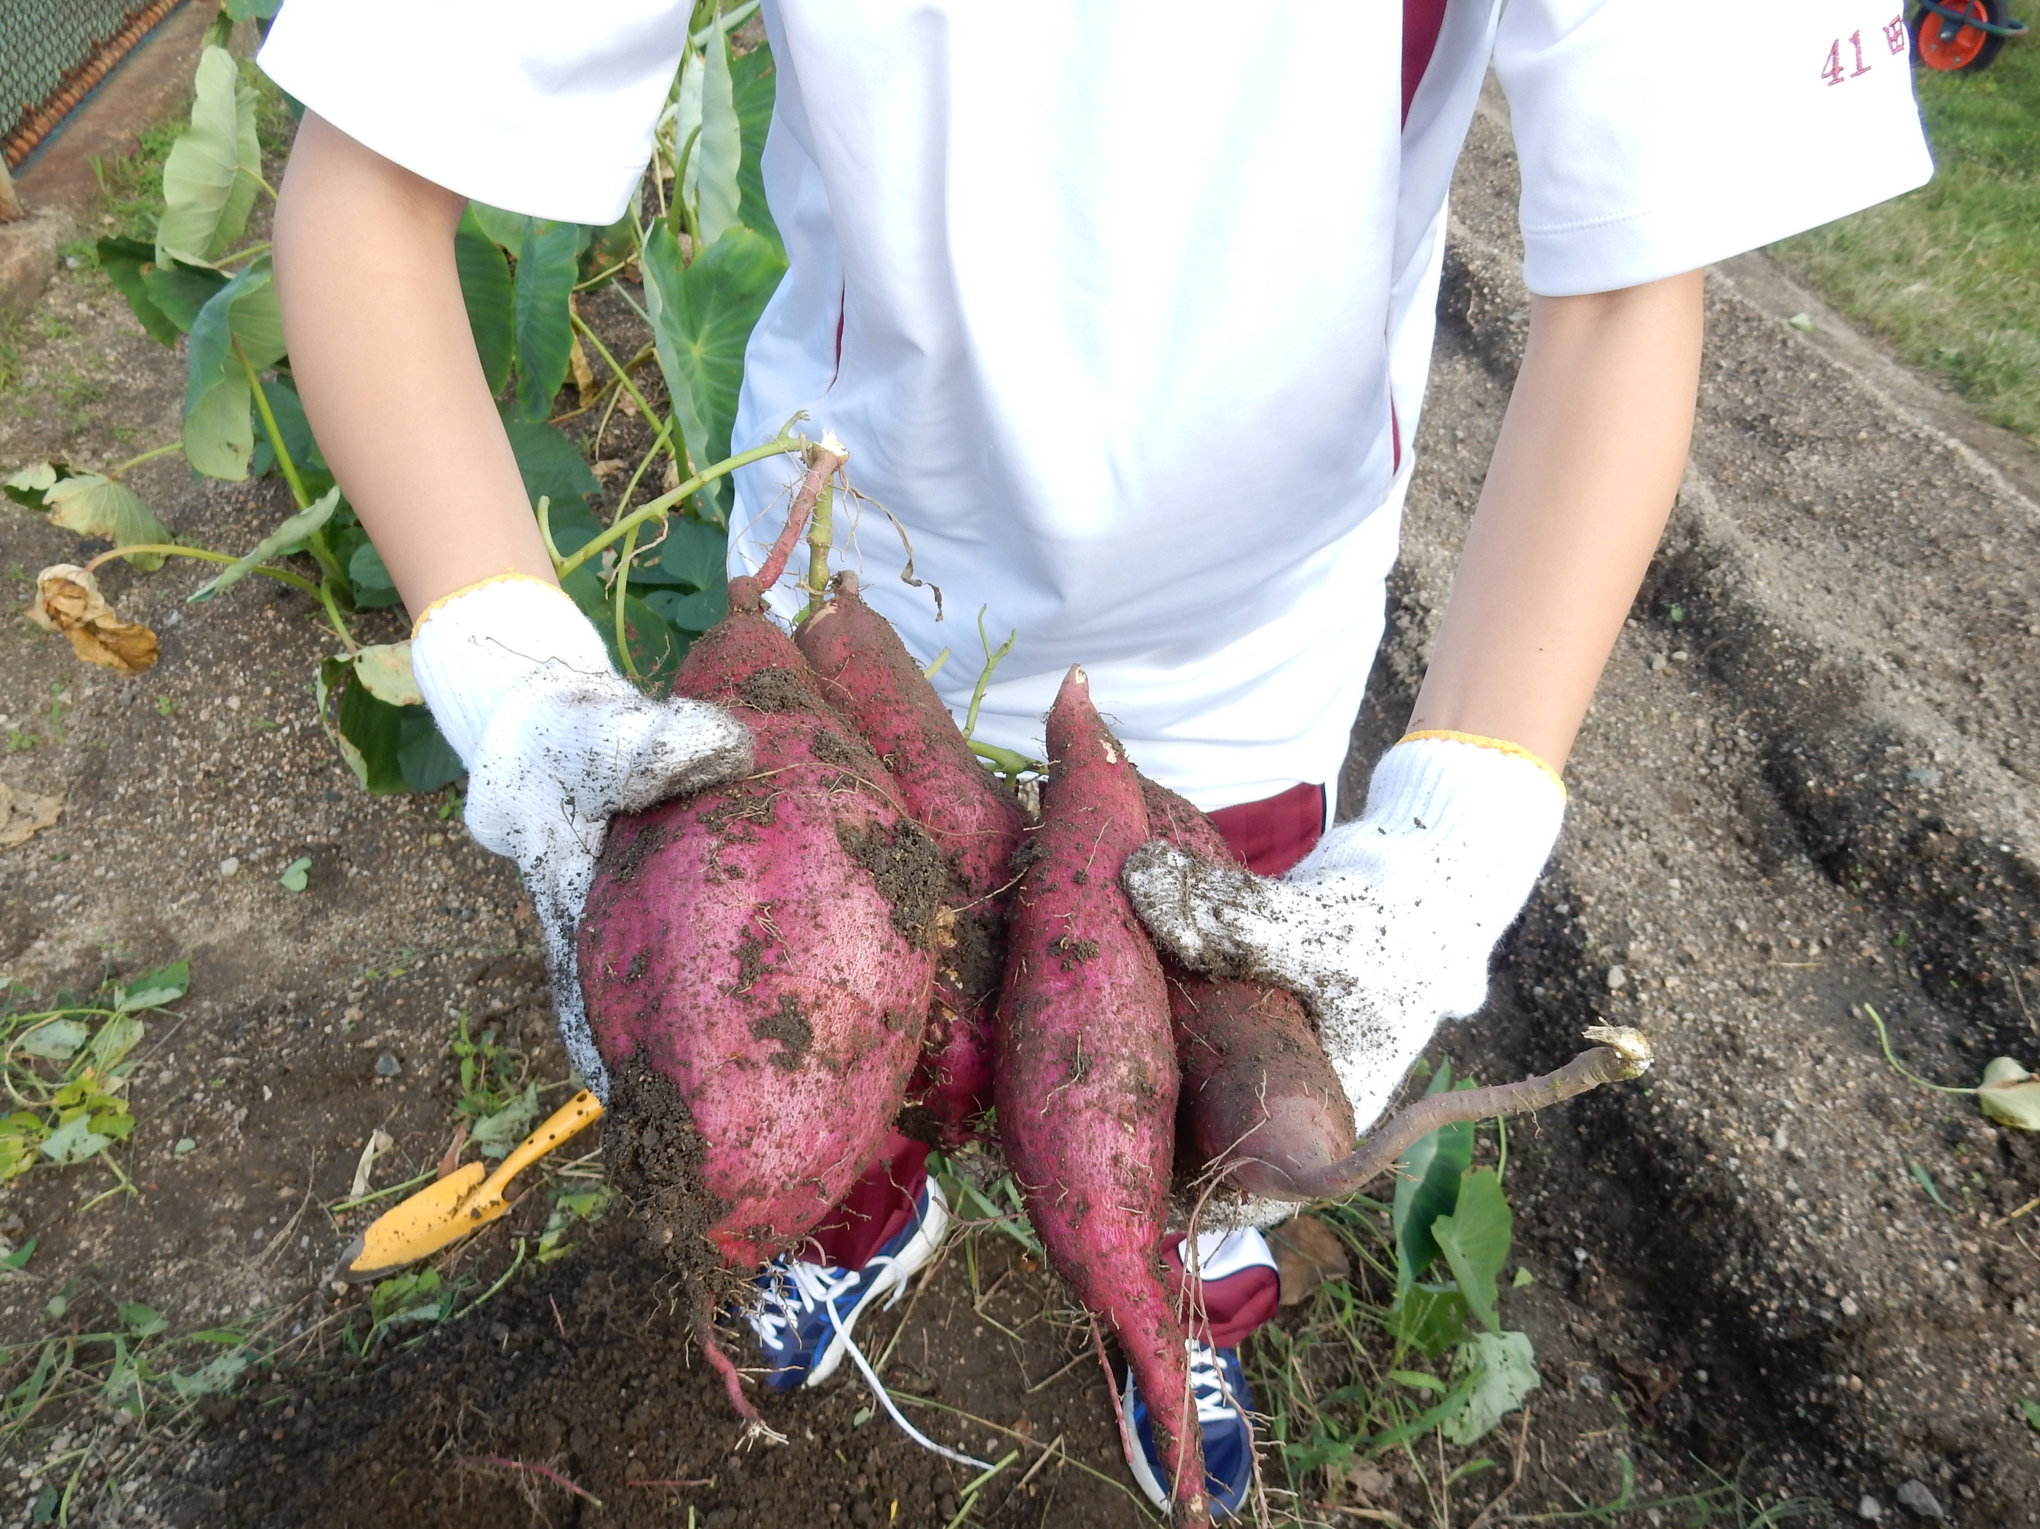
Growing sweet potatoes

Slide 9
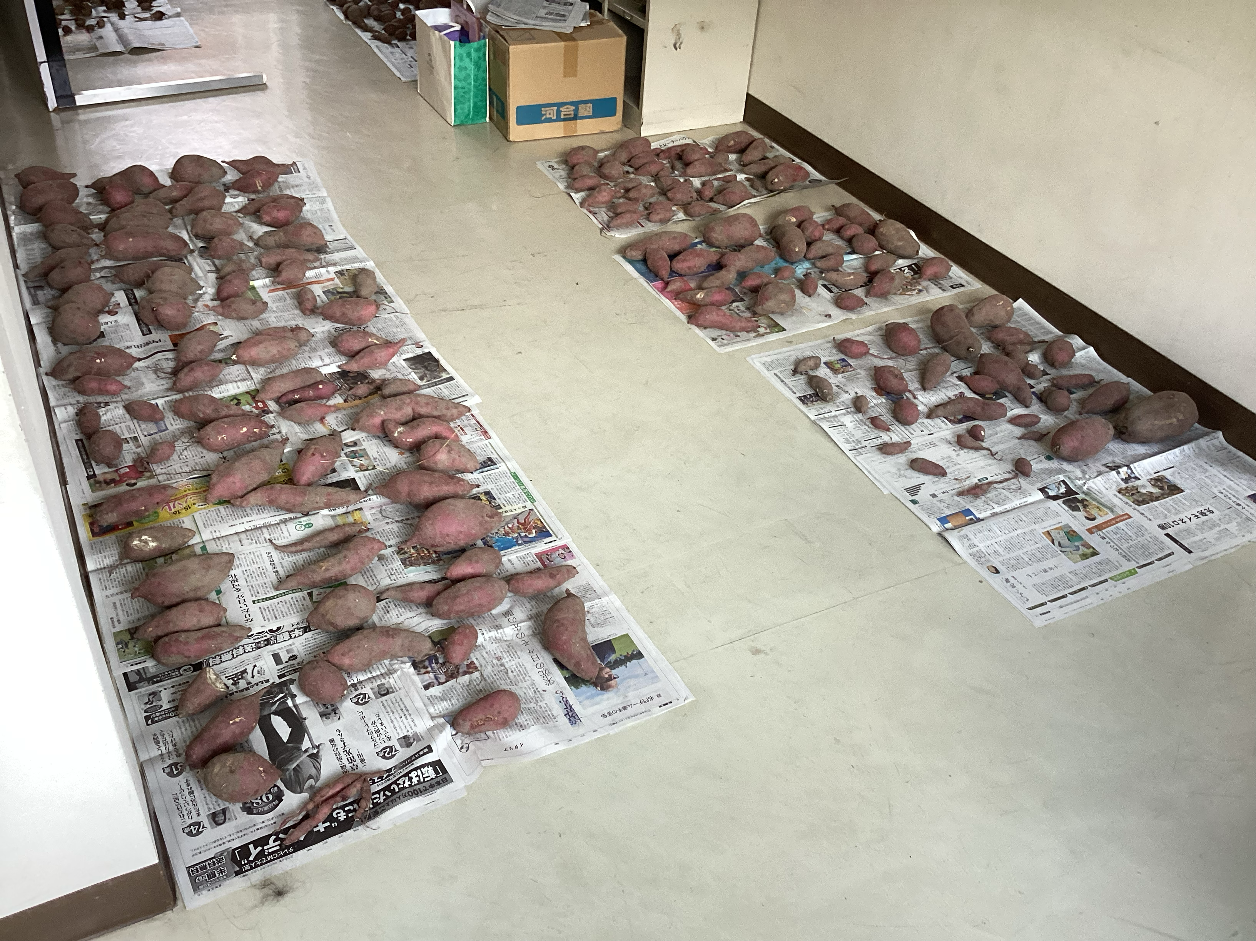
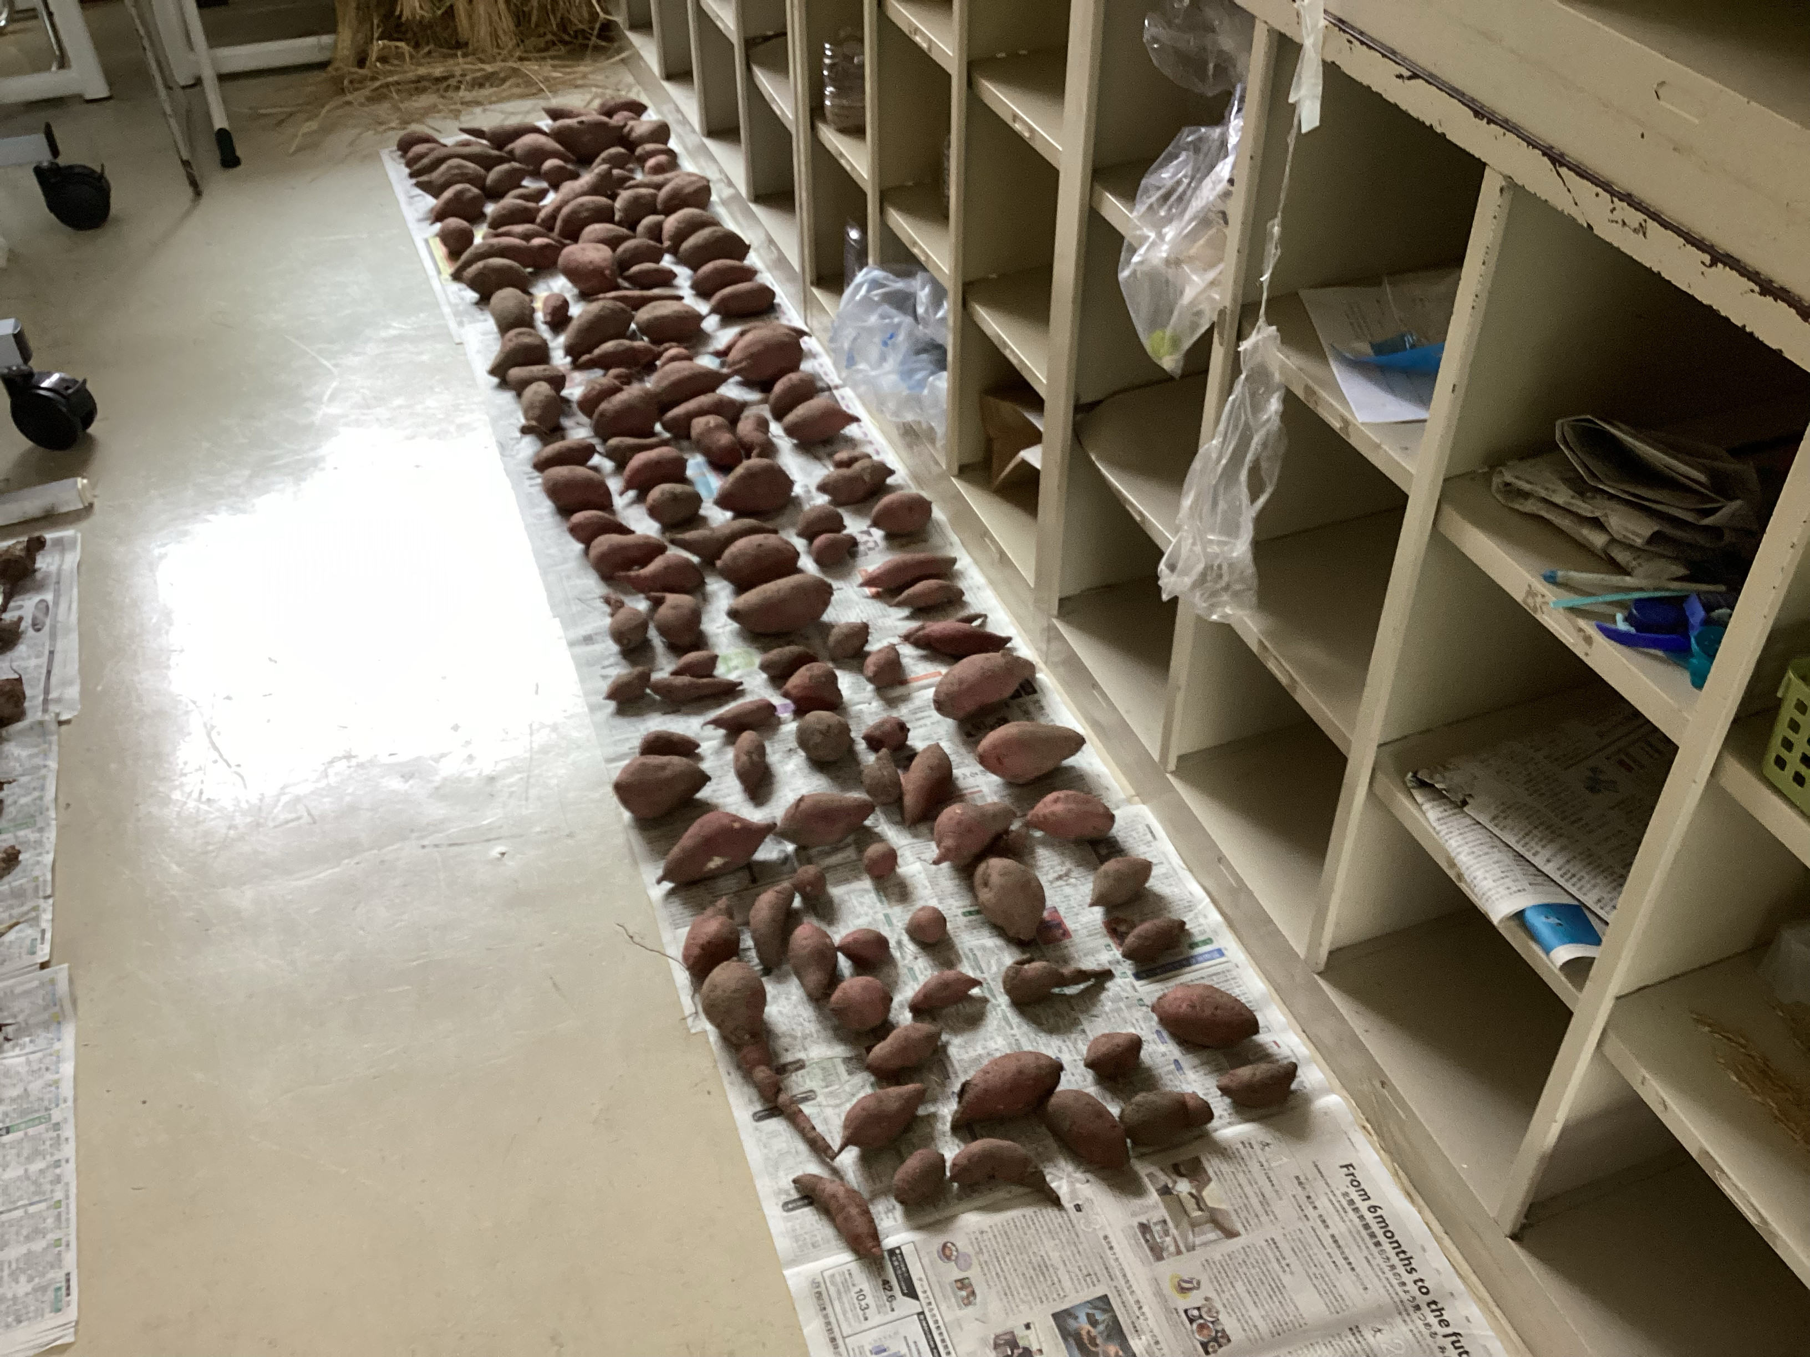
Growing sweet potato

Slide 10
Thank you for listening!!

